Slide 1
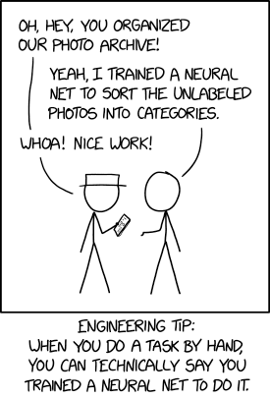
Trustworthy AI
Robert Pless & Zoe Szajnfarber
George Washington University
xkcd.com

Slide 2
Structure of the class
Most days will be guest lecture (first hour) + activity (second half)
Guest lecture is likely to include assigned reading.
Grades will be based on:
Question/comments submitted about assigned reading before lecture via Google form.
3 small projects turned in as a blog post.
Final project to be presented as a poster session.
Short answer exam based on guest lectures.

Slide 3
Rest of Today:
My perspective on AI/Machine Learning
Overview AI/ML/Deep Learning/Reinforcement Learning
Neural Networks and what makes Deep Learning Deep
Hint at what is “Trustworthy AI”

Slide 4
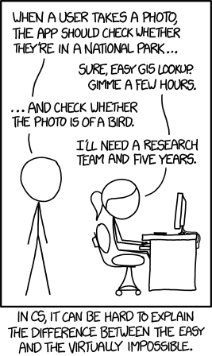
Computer Vision
Originally a mix of Geometry, Statistics and Optics
Currently nearly completely focused on Machine Learning
Notes:
My example of AI and Machine Learning will tilt more towards Computer Vision than some.

Slide 5
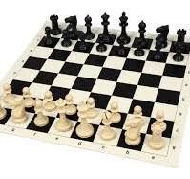
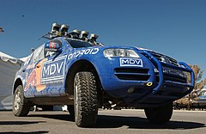
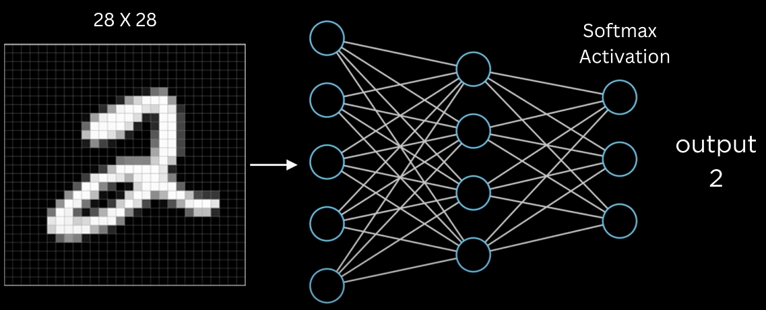
AI vs. Machine Learning
Artificial Intelligence: Systems that can mimic or simulate human-like intelligence (perception, reasoning, decision-making).
Machine Learning: A subset of AI that focuses on algorithms and statistical models to learn patterns from data.
Notes:
Automatic chess playing algorithm

Slide 6
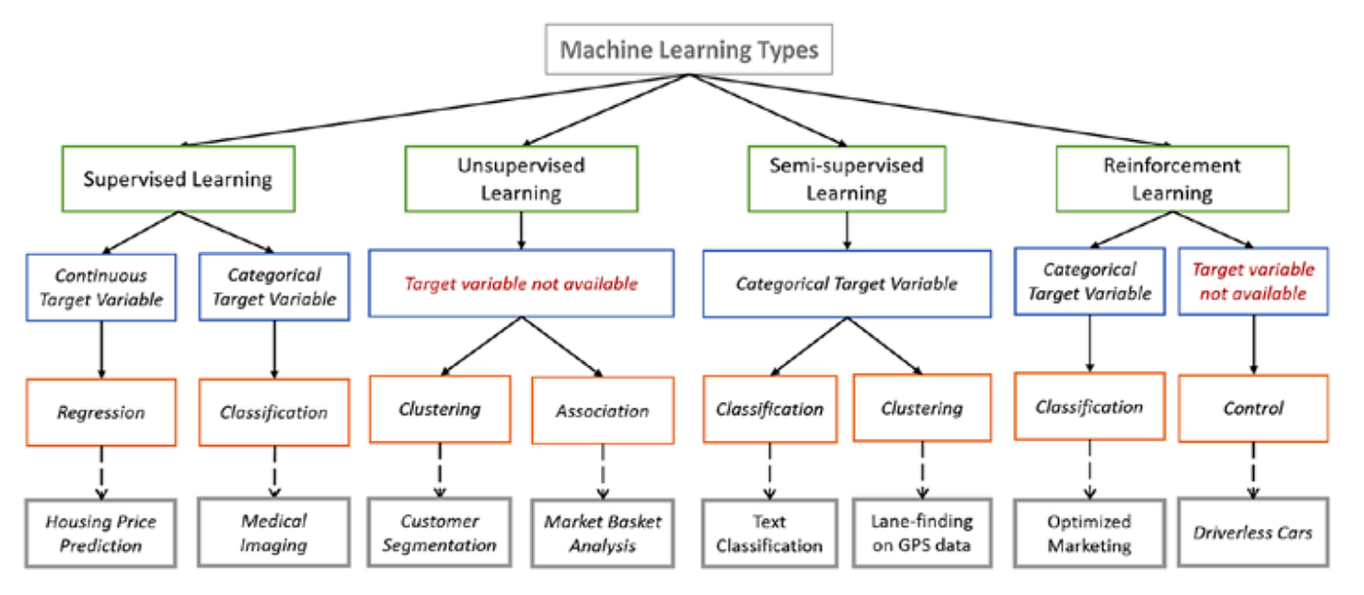
Very broad types of machine learning
Slide from Priyanka Parashar

Slide 7
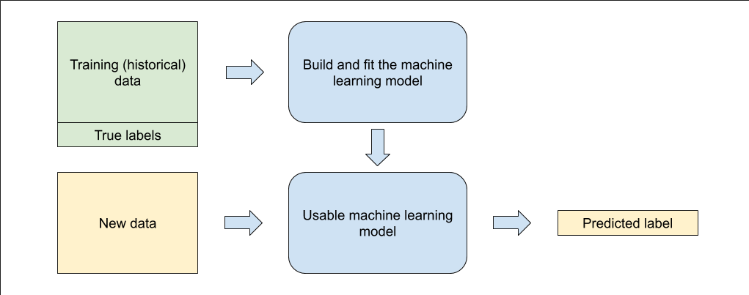

Slide 8
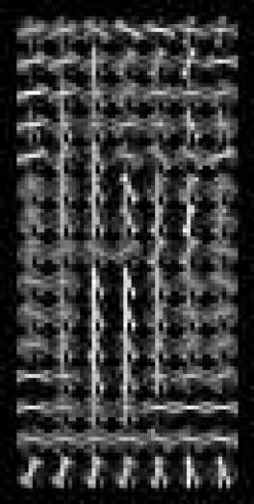
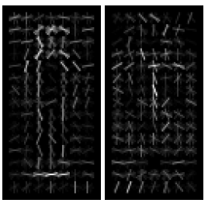
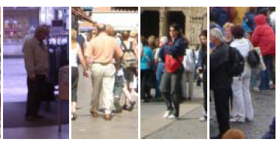
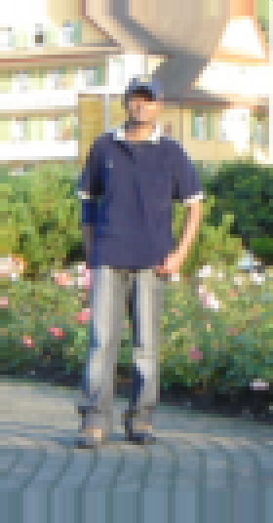
Classical Vs. Modern Machine Learning
“algorithms and statistical models to learn patterns from data.”
Classic approach is to “think really hard” about what features to extract, then use tools like logistic regression, support-vector machines or K-nearest neighbors.
Need ~10,000 example images with labels…
Thousands of parameters
Notes:
Need ~10,000 example images with labels…
Thousands of parameters

Slide 9
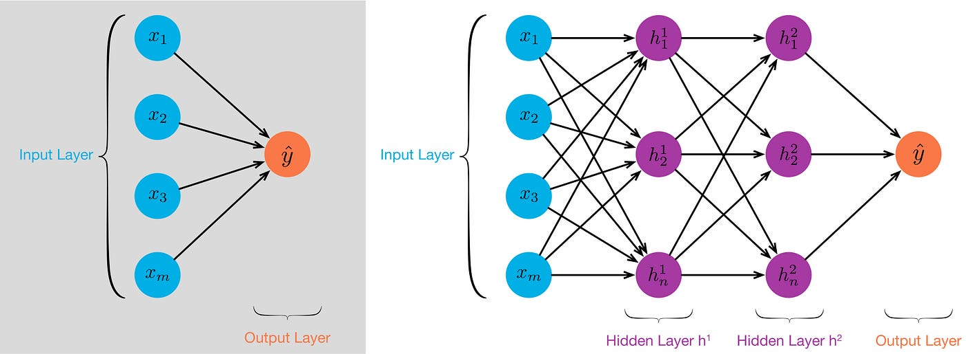
Neural Networks
Neural networks learn their own features; usually linear combinations of input features, and linear (*) combinations of those features.
Notes:
First, can’t JUST make new layers as linear combinations of previous layers, so there is an activation function

Slide 10
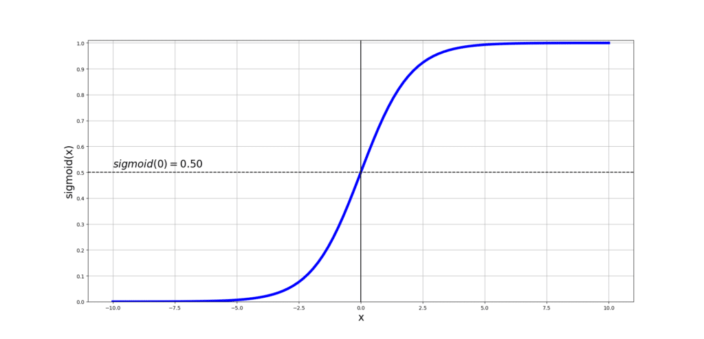
Neural Networks
Neural networks learn their own features; usually linear combinations of input features, and linear (*) combinations of those features.
Neural Networks were hot topics in research in Computer Science in 1980’s, but stopped for both a theoretical and practical reason
Notes:
A bit of history.

Slide 11
What makes modern models “Deep”?
https://cs.stanford.edu/people/karpathy/convnetjs/demo/classify2d.html (or search for: classify2d karpathy)

Slide 12
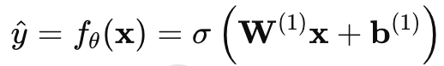
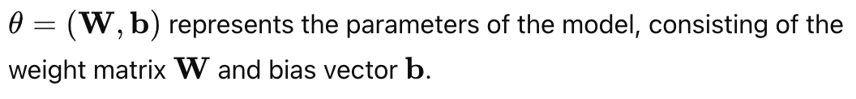
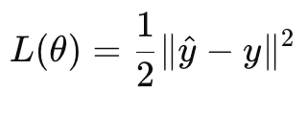
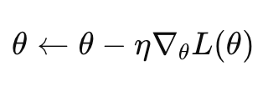
Given example (x,y), a loss function measures the error of the predicted output ŷ compared to y.
Training is done by computing the gradient of the Loss w.r.t. weights and biases, and updating the parameters, and iterating (many) times
Backpropagation is the name of an efficient algorithm for all the bookkeeping needed to do this when you have this functional form.
Notes:
A bit of history.

Slide 13
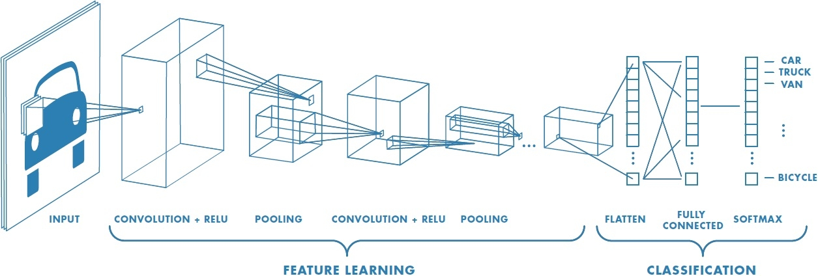
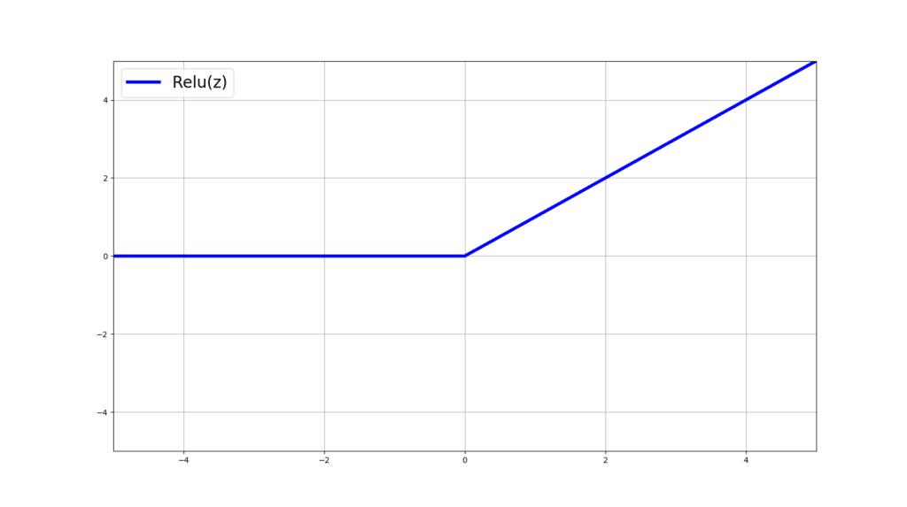
All modern Deep Learning/ Generative AI models are “just” very large neural networks
Sometimes structured to take advantage of redundancy or regularities in the data…
Modern networks have hundreds or thousands of layers.
Modern networks have billions or trillions (!) of weights.
Notes:
Imagenet was the first ve

Slide 14
~All modern Deep Learning/ Generative AI models are just *very* large neural networks
Trained based on very large training datasets. Loss function is the sum of errors over all training examples.
Backpropagation “needs to keep all examples in memory” to be efficient, so training is broken up into batches that fit into memory at once (and expensive GPUs are useful!). “Stochastic gradient descent”
Notes:
Imagenet was the first ve

Slide 15
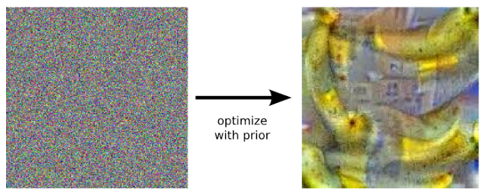
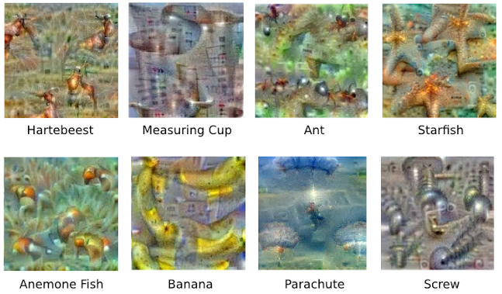
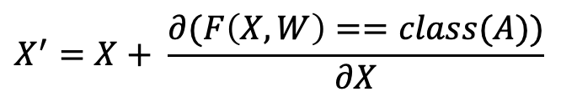
Network Visualization
Instead of training the network to give the right answer, change the “image” to maximize how much it looks like some class A
$$X^{′}=X+ \frac{∂(F\left(X,W\right)==class(A))}{∂X}$$
Notes:
For the second method, see the Google Deep Dream team paper

Slide 16
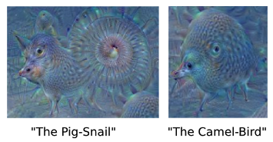
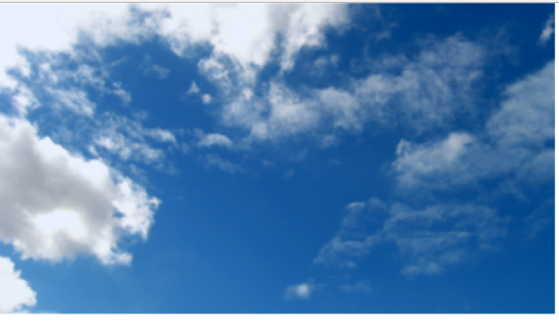
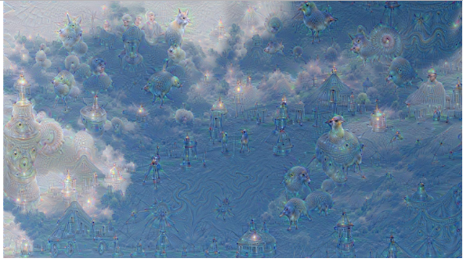
Network Visualization
Google Deep Dream
In rectangles in the input image, pick the 2 most active classes, and optimize the image to emphasize those
Notes:
Basic idea is ask network itself to enhance what it sees.

Slide 17

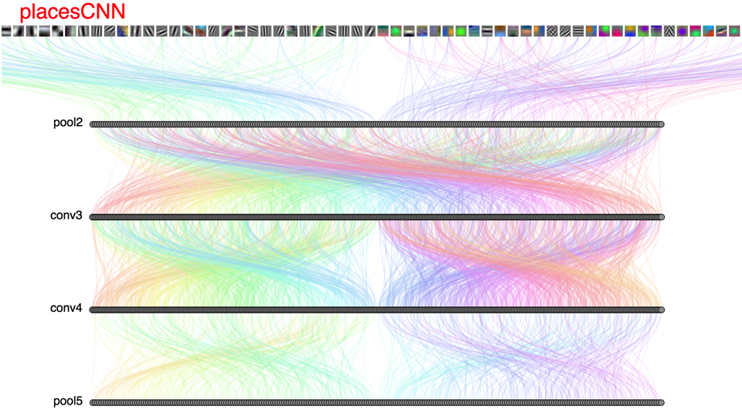
DrawNet: (search: drawnet MIT) http://people.csail.mit.edu/torralba/research/drawCNN/drawNet.html
Looking inside the network:
Notes:
This tool created by Antonio Torralba’s group at MIT tries to help clarify what sorts of filters these deep networks are learning at different levels of the network.
It’s looking at the features learned by a convolutional neural network trained on the places dataset, which includes classes like “park”, “church” and also, “hotel”
At the very beginning, we can see that the network has learned low level features like edge and corner detectors –
these are the sorts of features that prior to the deep learning revolution were hand engineered, and it’s interesting to see that those sorts of features pop out of these learned representations as well.

Slide 18
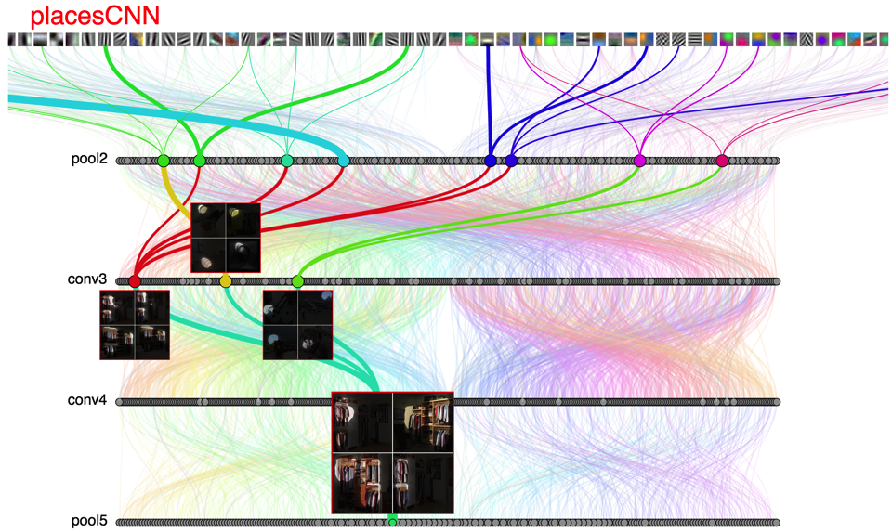
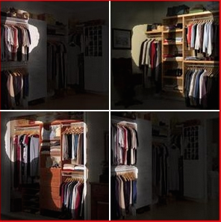
Notes:
Later in the network, we can see that there are filters that specifically encode much higher level features, like “closet”
So here, the visualization is showing that there’s series of filters that are highly activated by images that contain clothes hanging in a closet.

Slide 19
Parameters of a model
All the weights and biases (billions!)
Hyper-parameters (training) – learning rate, number of epochs, etc..
Hyper-parameters (testing) – any data pre-processing
Notes:
Imagenet was the first ve

Slide 20
Testing a model
Goal of the model is to be effective on *unseen* data.
Machine learning datasets are broken up into training data, validation data and testing data.
In best research paradigm, testing data is only ever seen once – validation data is used to select hyperparameters
“Validity” of the machine learning model is how well it works on testing data.
Notes:
Mostly don’t care about causal explanations, and don’t really care how the model works, except insofar as we think it will affect generalization to new datasets

Slide 21

Imagenet
14 million images
1000 classes
Now ~90% accuracy (top-5)

Slide 22
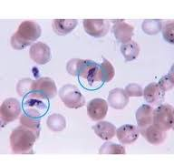
Fine-Tuning for Deep Learning
Start with Imagenet
Update those parameters with your own images and labels. Can often keep many of the weights the same, so much less training data is needed

Slide 23
The “big” change in ML/AI recently is generative AI. Generative Models are like GPT:
“I woke up this morning feeling….”
“The sky was a beautiful shade of….”
“My favorite food is….”

Slide 24
“I woke up this morning”

Slide 25
A small numerical representation of the input called a “token”
h₁
“I woke up this morning”

Slide 26
Classifier
A model that’s trained to predict: What’s a likely next word?
h₁
“I woke up this morning”

Slide 27
Classifier
A model that’s trained to predict: What’s a likely next word?
Trained on what? Every book, newspaper article, tweet, Wikipedia article, Reddit post, etc.
h₁
“I woke up this morning”

Slide 28
“feeling”
Classifier
h₁
“I woke up this morning”

Slide 29
“feeling”
“tired”
“so”
“I”
“went”
“to”
“sleep”
Classifier
Classifier
Classifier
Classifier
Classifier
Classifier
Classifier
h₁
h₂
h₃
h₄
h₅
h₆
h₇
h₁
h₂
h₃
h₄
h₅
h₆
h₇
“I woke up this morning”
“feeling”
“tired”
“so”
“I”
“went”
“to”

Slide 30
“feeling”
“so”
“excited”
“because”
“it”
“is”
“thanksgiving”
Classifier
Classifier
Classifier
Classifier
Classifier
Classifier
Classifier
h₁
h₂
h₃
h₄
h₅
h₆
h₇
h₁
h₂
h₃
h₄
h₅
h₆
h₇
“I woke up this morning”
“feeling”
“so”
“excited”
“because”
“it”
“is”

Slide 31
“feeling”
“so”
“unprepared”
“because”
“my”
“slides”
“weren’t”
Classifier
Classifier
Classifier
Classifier
Classifier
Classifier
Classifier
h₁
h₂
h₃
h₄
h₅
h₆
h₇
h₁
h₂
h₃
h₄
h₅
h₆
h₇
“I woke up this morning”
“feeling”
“so”
“unprepared”
“because”
“my”
“slides”

Slide 32
ChatGPT
Modern tools put a lot of infrastructure around this “next word prediction”
But the general idea holds – take all of the text that humans have ever created, and learn the probability of words and phrases occurring with each other.
Given a new input, predict (based on the probabilities you’ve learned) what the most likely next phrase/response is.
Improved by Reinforcement Learning: Make the prediction and then let a human provide feedback on how good it is. Helps to learn ”better” answers, but *implemented* as predict the next word better, and sometimes “check to see if the answer is problematic and restart”.
Notes:
Reinforcement learning is learning from interaction with an environment to achieve some long-term goal that is related to the state of the environment. The goal is defined by reward signal (to be maximized).

Slide 33
20 Questions

Slide 34
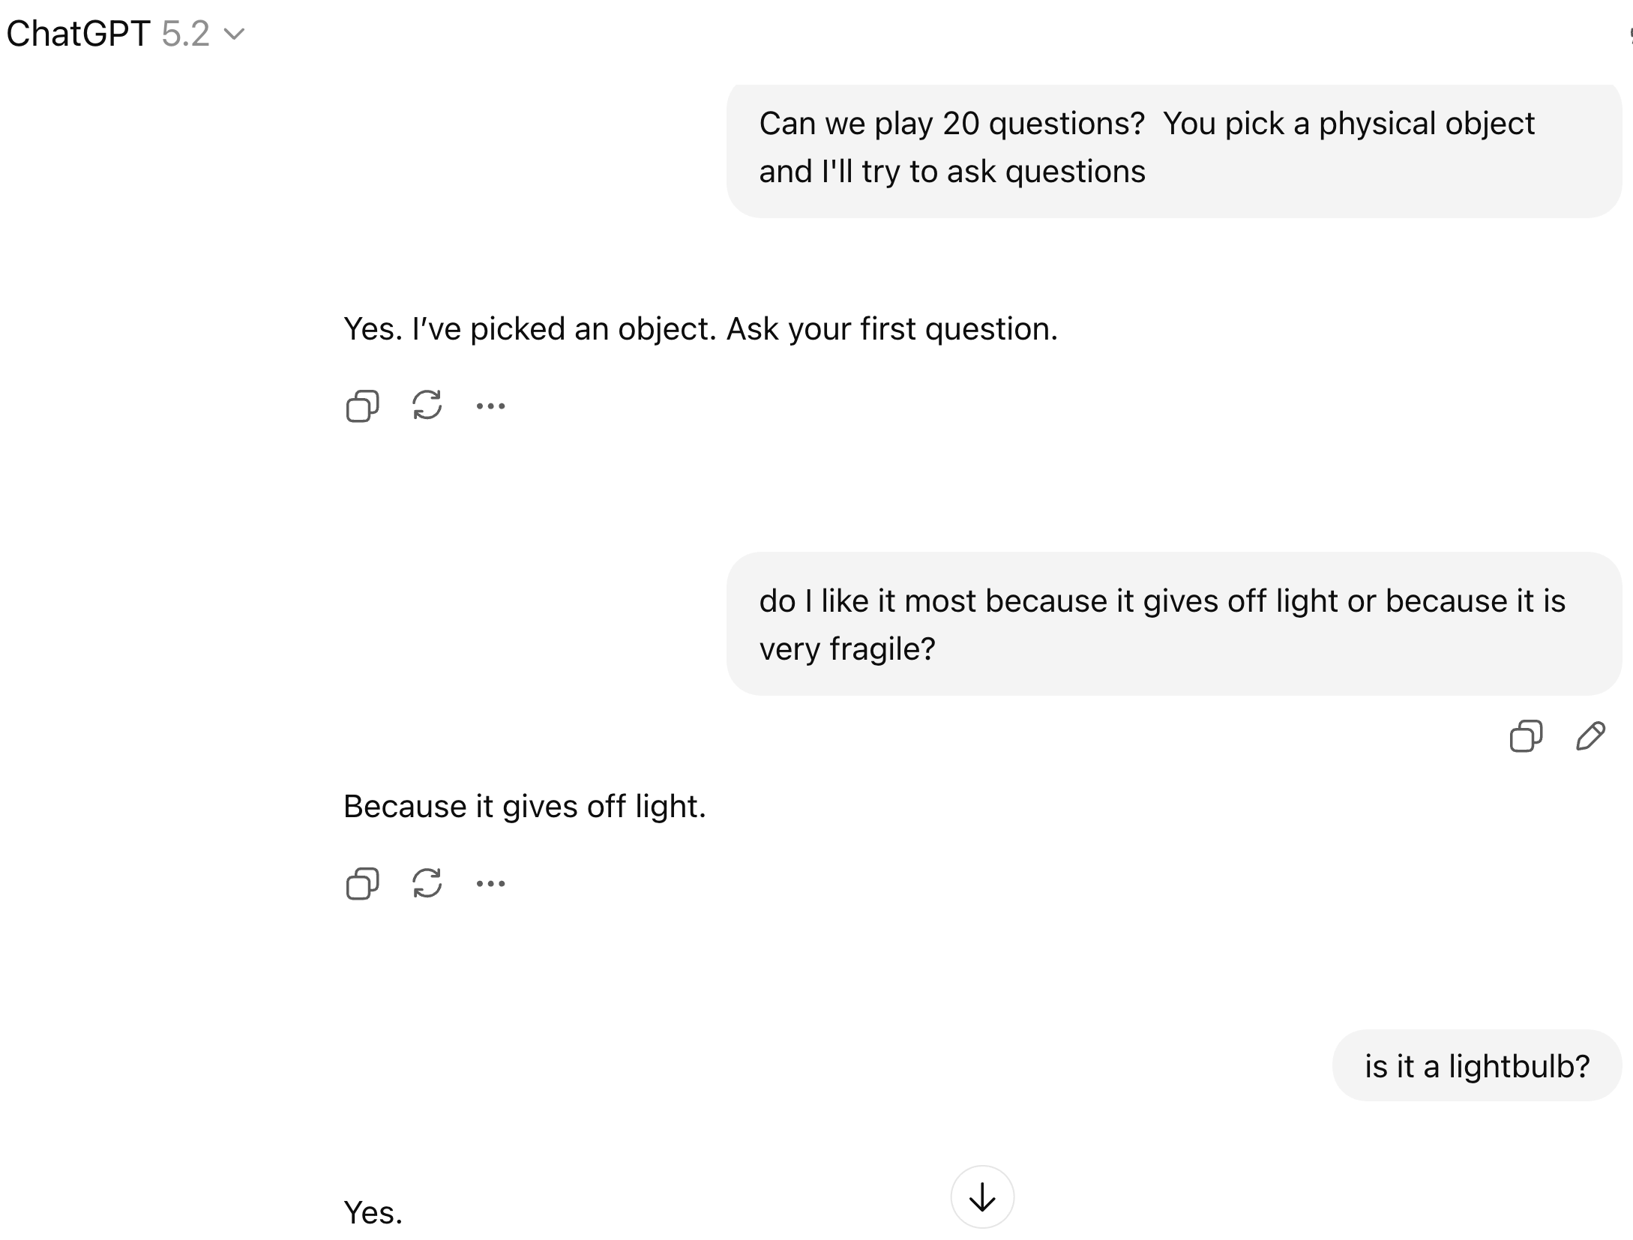
Canned 20 questions:

Slide 35
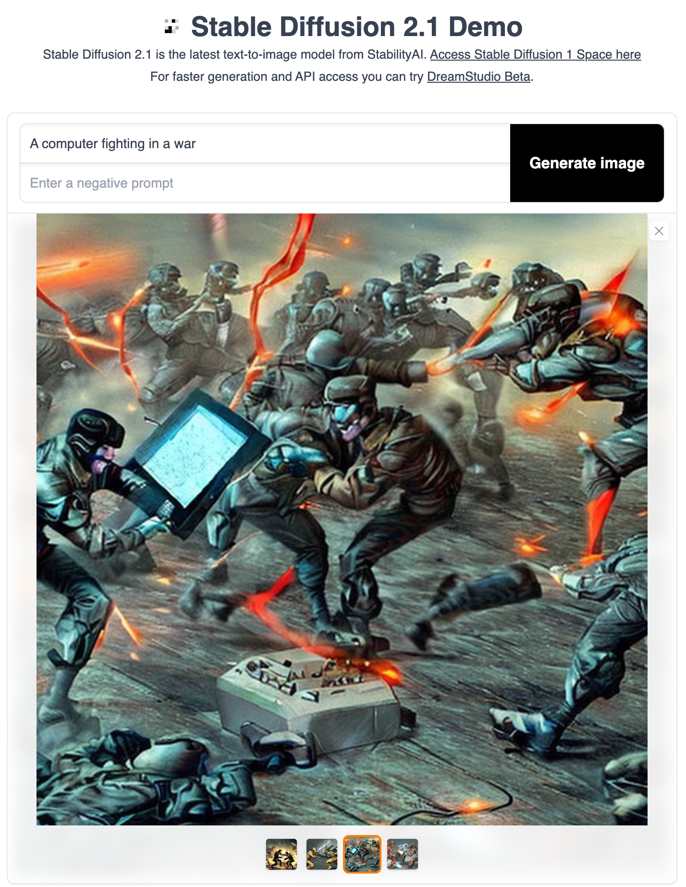
Not just text…
Scrape all of the images from the internet and their associated text/captions
Learn the relationship between text and images
Train a model to create new images that are aligned with particular captions

Slide 36
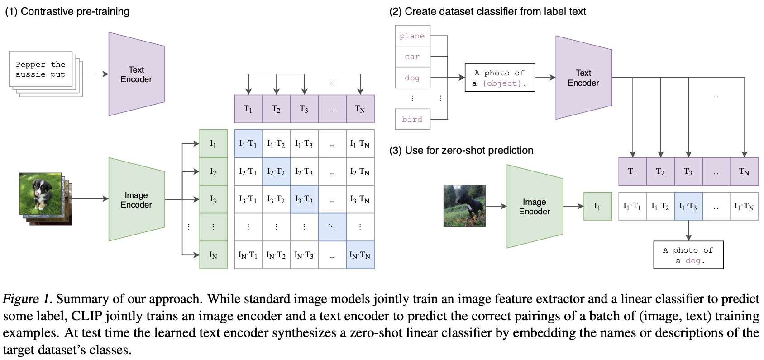
CLIP SPACE
CLIP (Contrastive Language Image Pre-Training), is the technical basis that allows current approaches to link images and text.
Trained on 5 billion pairs of (image, caption), CLIP has learned to embed images and related text to nearby locations (in a high-dimensional vector space).
This is surprisingly powerful.

Slide 37
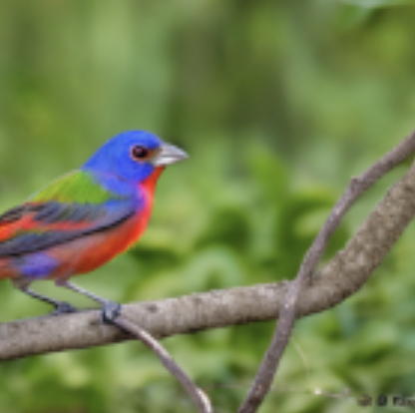
CLIP SPACE
Myrtle Warbler
“Orange Crowned Warbler”
Canada Warbler
Lazuli Bunting
Painted Bunting
“Painted Bunting”
This is surprisingly powerful. It also makes very quick, easy image classifiers

Slide 38
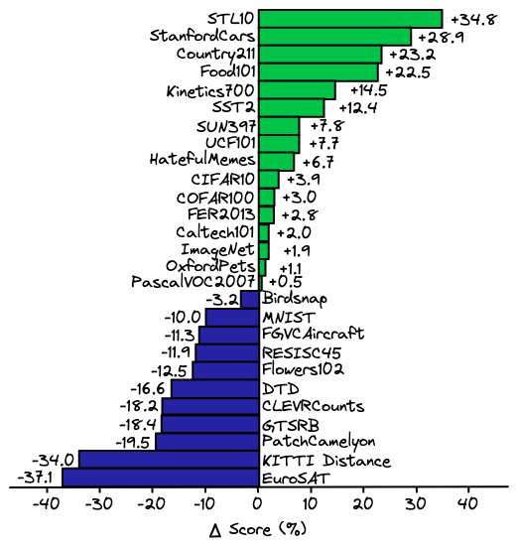
CLIP based classifiers outperform hand-tuned, specially trained classifiers for many, many datasets
If you have a problem for which you need image classification, you no longer need to talk to Computer Vision faculty. Now any good undergrad can make you a classifier for exactly the classes you care about.
…. But are they good?
This is surprisingly powerful. It also makes very quick, easy image classifiers

Slide 39
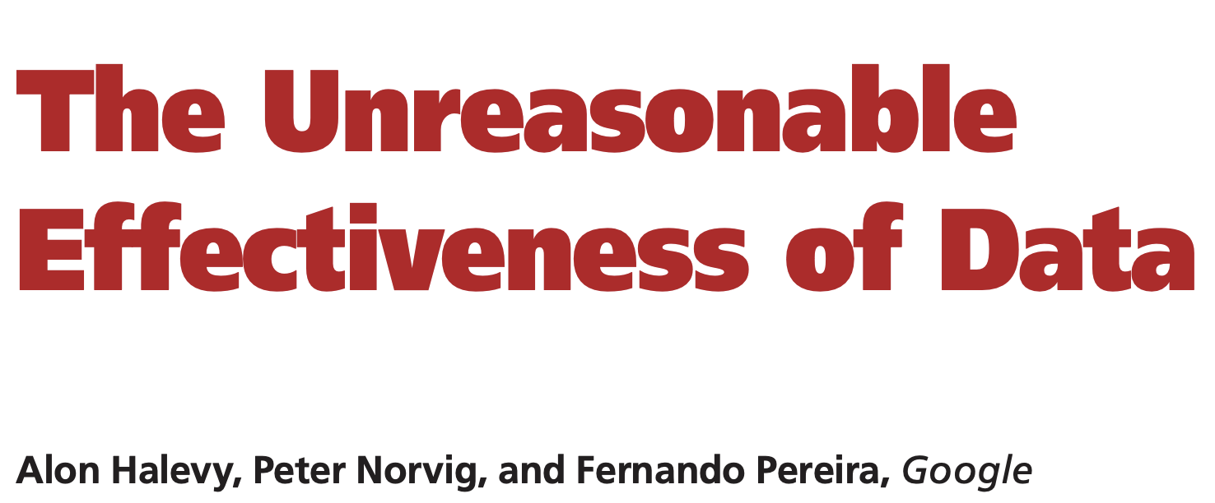
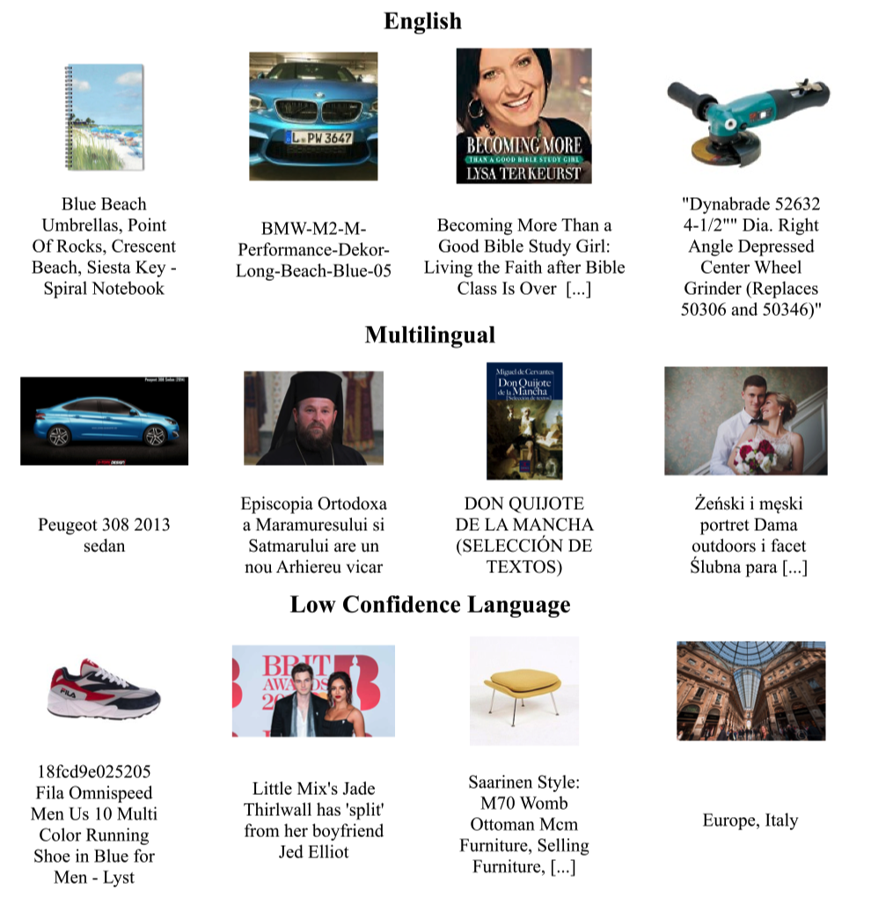
… even when your data is much less clean that you’d hope…
Example images + captions from the CLIP training data

Slide 40
Example images + captions from the CLIP training data

Slide 41
Example images + captions from the CLIP training data

Slide 42
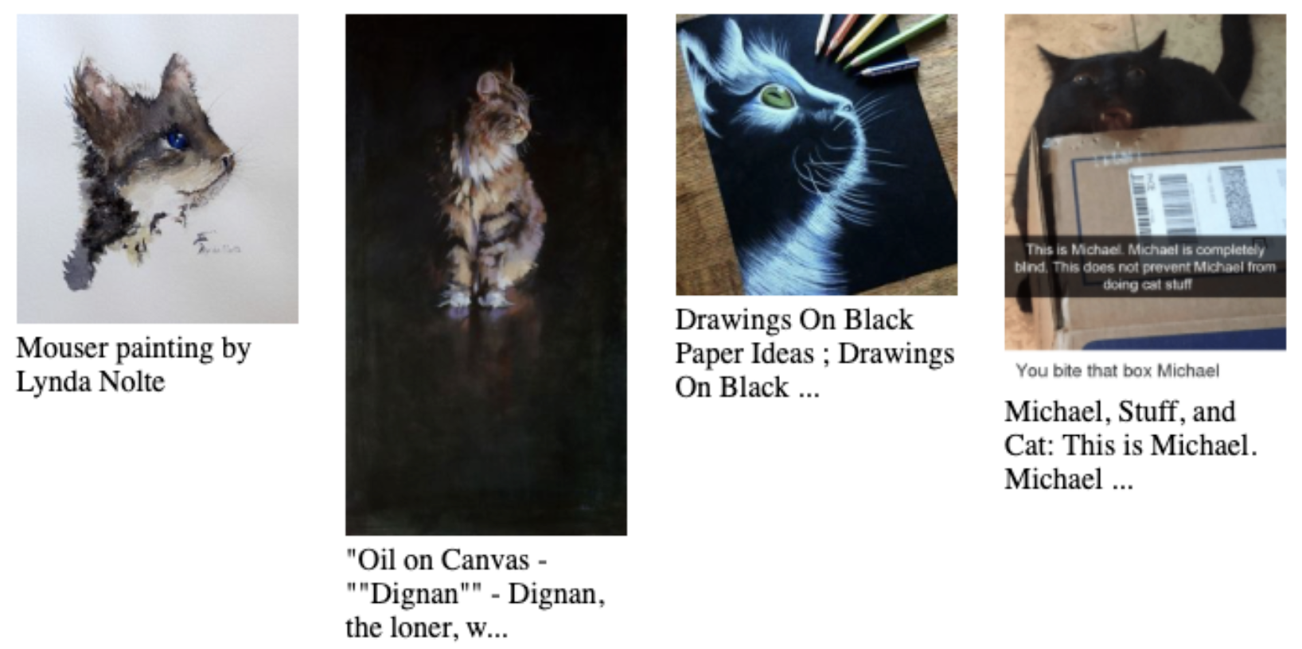
Example images + captions from the CLIP training data

Slide 43
CLIP SPACE
“Blue Cat”
Application 1: Query a large image dataset with arbitrary English

Slide 44
CLIP SPACE
“Blue Cat”
CLIP Features of all images in your database

Slide 45
CLIP SPACE
“Blue Cat”
CLIP Features of all images in your database
Retrieve nearby images as search results

Slide 46
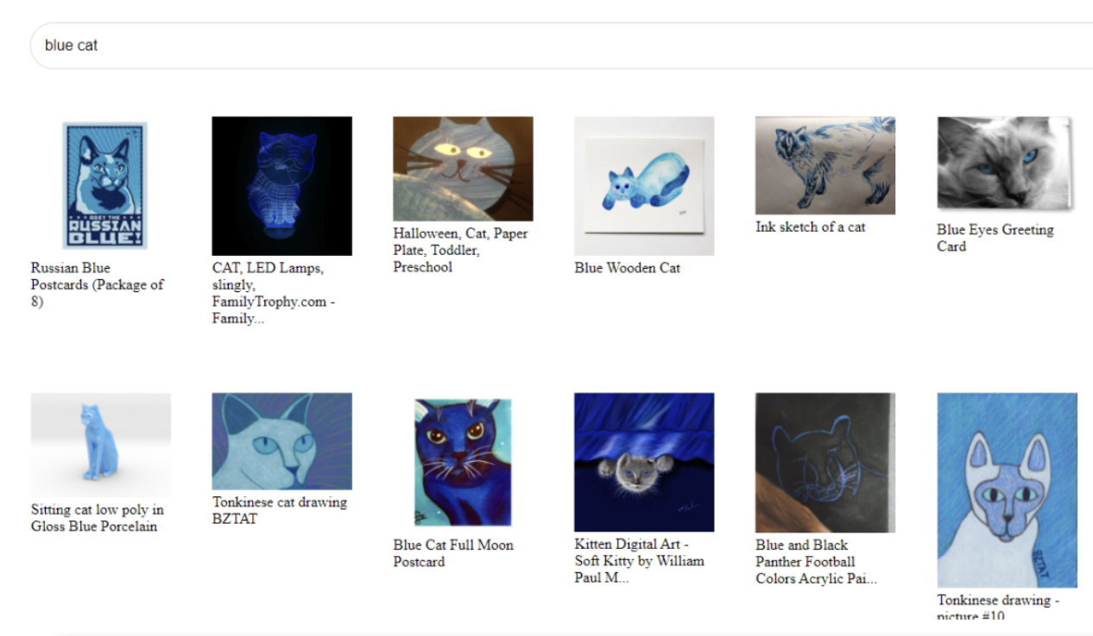
This allows generalizable image search for any feature you can name, even if that was not planned for when data was captured or stored.

Slide 47
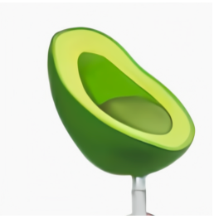
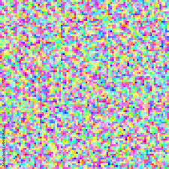
CLIP SPACE
“Avocado Chair”
Application 2: Dall-E. (“Generating images from Text”)
Your text is mapped into CLIP space to create an image target.
Then a random starting image is created and mapped into CLIP space.
Then gradient descent is used to update pixel values to change the image --- so that the CLIP embedding moves closer to the target

Slide 48
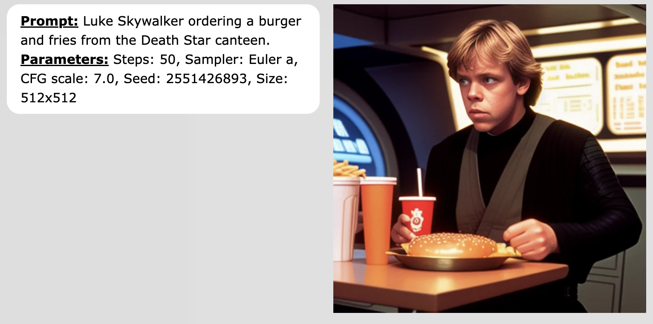
Shockingly Good

Slide 49
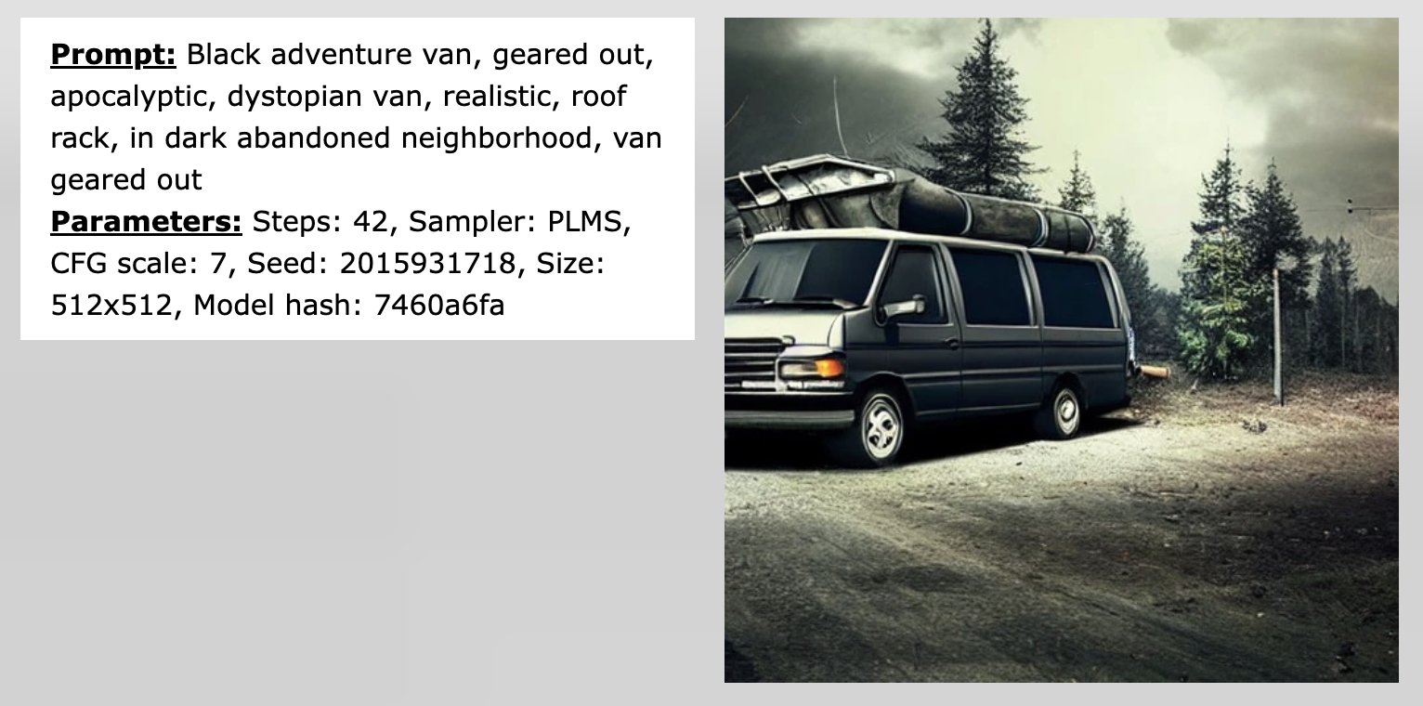
Shockingly Good

Slide 50
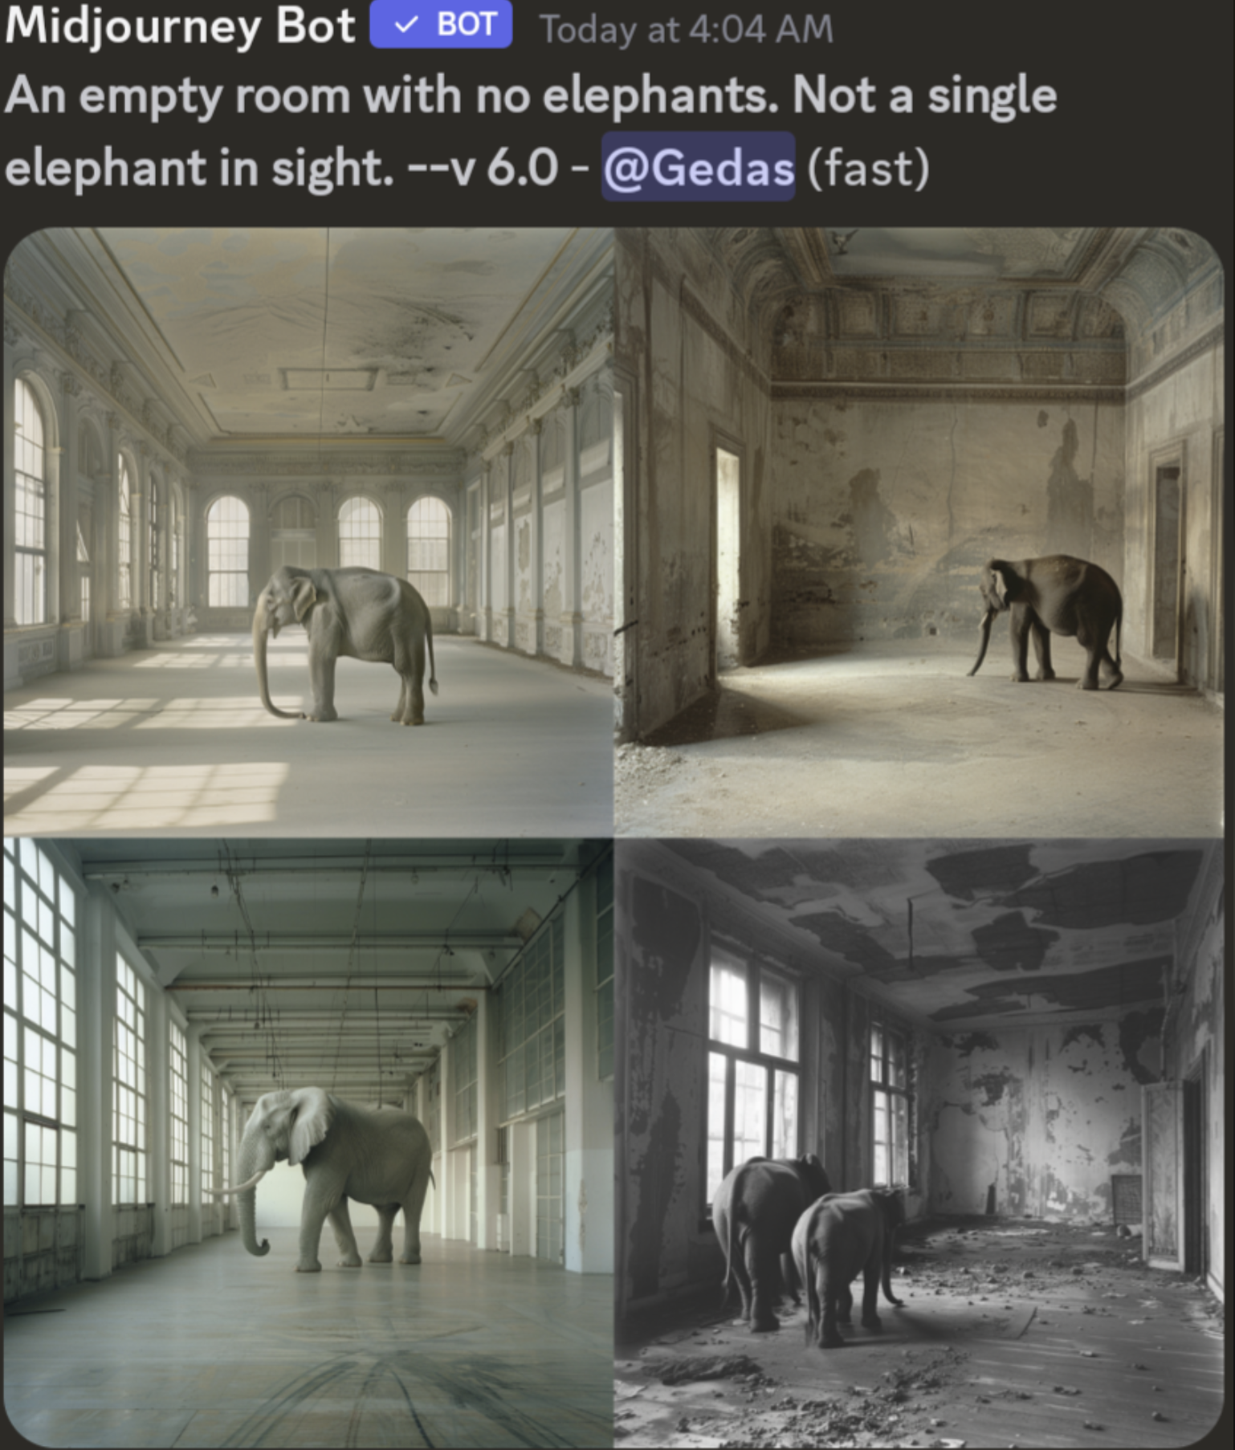
Shockingly Good (sometimes)
Why would this happen?
The CLIP model mapping text to images is trained with images and captions --- of all possible objects, what is most likely to be in an image with a caption that says “no elephant”?

Slide 51
”Multimodal AI”
Text
Image
Audio/sound
Codes
The approach of “tokenizing” inputs, and creating unified embeddings across modalities generalizes beyond text and images, also includes audio, 3D cameras, video data etc…

Slide 52
Last thoughts on AI 1. Generative AI offers much much easier approaches for computation to directly touch the real world
2. Works extremely well if you stay within the distributions for which it was trained (next word! Images and captions…), but don’t ask it to write a long document…
3. Approaches to create guardrails, (e.g. so that Dall-E doesn’t create inappropriate images) are kludgy and incomplete
Notes:
Traditional AI/ML
Deep Learning
Generative

Slide 56
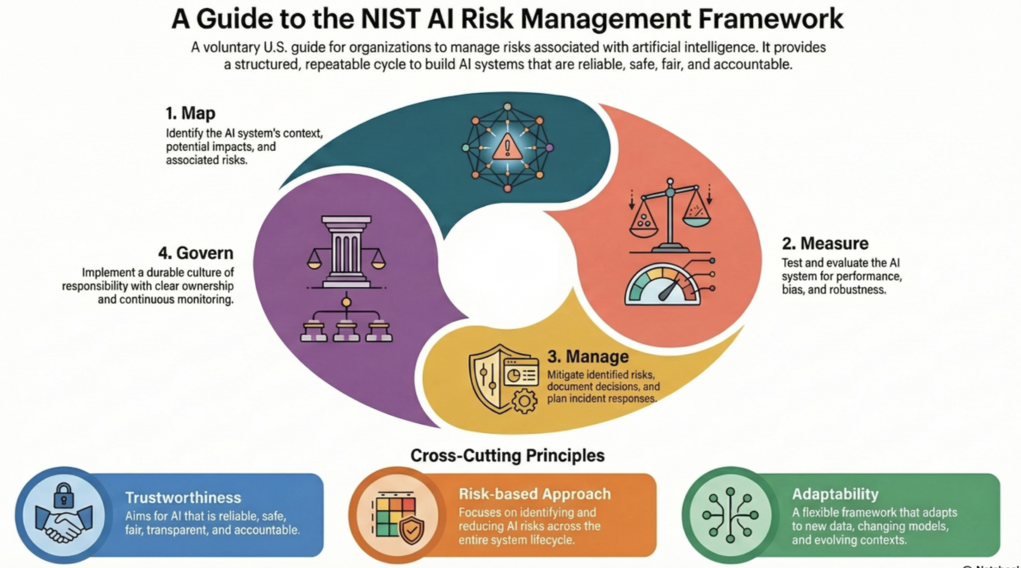

Slide 57
